Slide 1
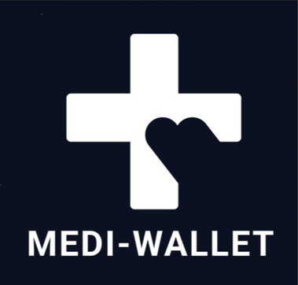
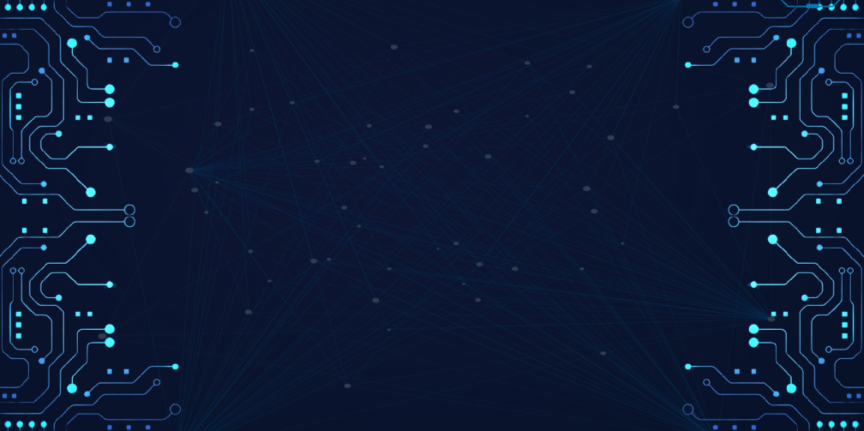
InnovAct 2025
TRACK CHOSEN: BLOCKCHAIN +AI/ML
PROBLEM STATEMENT TITLE: HEALTHCARE DATA CHALLENGES
TEAM NAME:
MEDIWALLET
YUKTI ID: IR2025-995911
TEAM MEMBERS: 1. KESHAV SUKHIJA: 23BIT0262
2. AAYUSH HEMANT SINGH:23BIT0226
3. AAKASH GURUMURTHI:23BIT0245
4. SHATAKSHI SINGH:25BYB0011
5.SAMBHAVI:25BIT0334

Slide 2


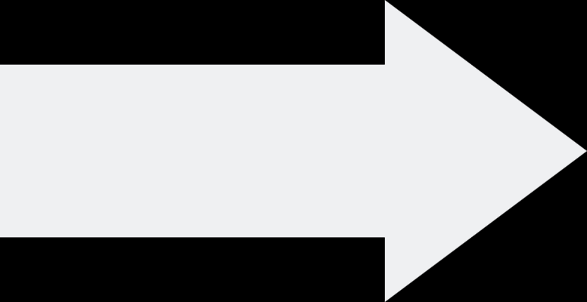
PROBLEM STATEMENT:
WHAT’S THE PROBLEM?
Patients often lack full control over their medical records.
Records can be tampered, lost, or accessed without consent.
WHY THIS PROBLEM IS RELEVANT!!
Healthcare decisions depend on accurate and complete records.
Data breaches and misuse of health data are increasing globally.
Lack of secure sharing delays treatment and increases patient risk.

Slide 3
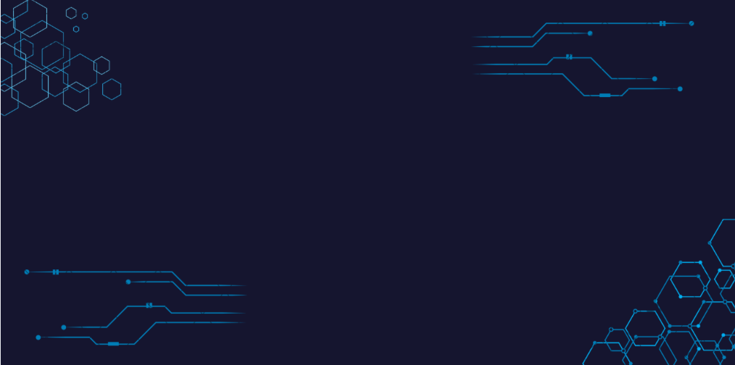
SUPPORTING STATS/EXAMPLES:
According to WHO, up to 30% of health records in developing countries are incomplete or misplaced.
Recent studies show over 50% of patients face difficulty sharing medical records across hospitals.

Slide 4


OBJECTIVES:
~To Build a Patient-Centric Platform where individuals can securely consolidate, manage, and own their complete medical history.
~ To Guarantee Data Integrity by using the Ethereum blockchain to create an immutable, timestamped ledger of every medical record's existence.
~To Empower Patients with Granular Control through a seamless sharing system, allowing them to grant temporary, view-only access to doctors and specialists via secure QR codes.

Slide 5
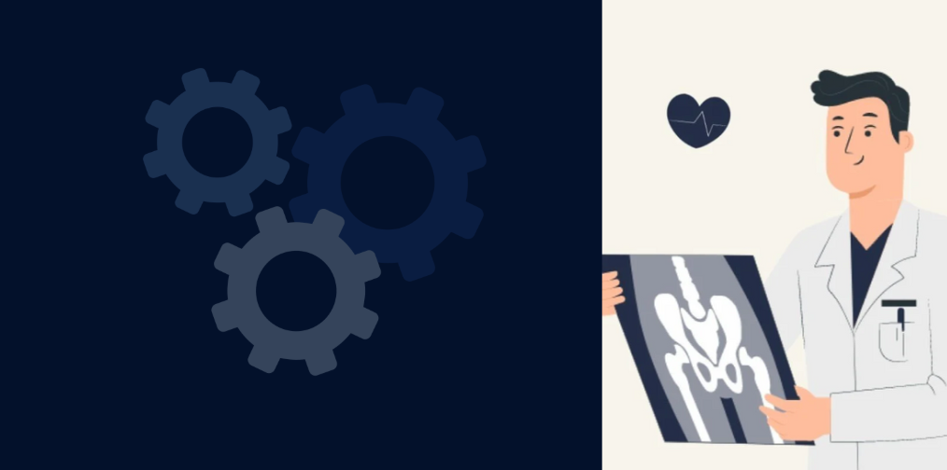

KEY FEATURES:
~Unified Patient Dashboard
> One place to upload, view, and manage all your health documents—PDFs, lab scans, images, and more.
> Makes tracking your medical history simple and organized.
~ Immutable Proof of Record
> Every document gets a unique digital fingerprint stored on the blockchain.
> This proves your file existed at a certain time and hasn’t been tampered with.

Slide 6


~ Privacy-First Design
> Your actual medical files are never on the blockchain.
> They’re stored securely off-chain (IPFS), and you control who can access them.
~ On-Demand Secure Sharing
> Share any record with a doctor using a temporary, single-use QR code.
> Doctors get read-only access, and you remain in full control.

Slide 7
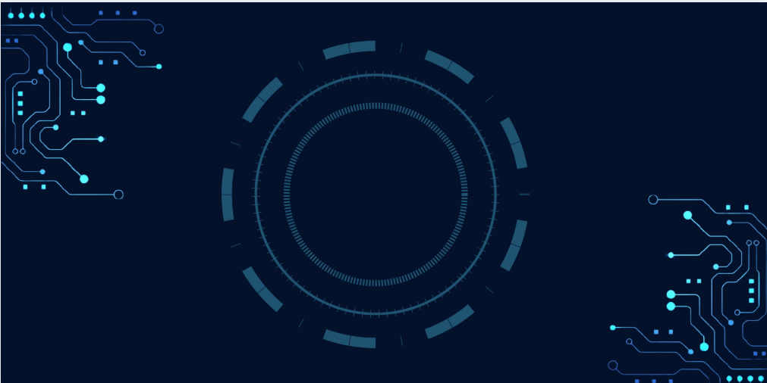


SYSTEM ARCHITECTURE:
How it works:
~ Patient Uploads File (React Frontend)
~ You upload your medical document through a simple, user-friendly dashboard.
~Backend Handles Storage (Node.js)
~ The backend sends your file to IPFS, a decentralized storage network.
~IPFS returns a unique content hash (CID) for your file.
Integrity Check
The backend creates a SHA-256 hash of the file to ensure it hasn’t been tampered with.
Blockchain Recording (Ethereum Smart Contract)
The file’s IPFS hash and metadata are stored on the blockchain.
This guarantees your record is immutable and verifiable.
Secure QR Code for Doctors
A unique QR code is generated for temporary, read-only access.
Doctors can scan it to view your records securely, without compromising your privacy.

Slide 8
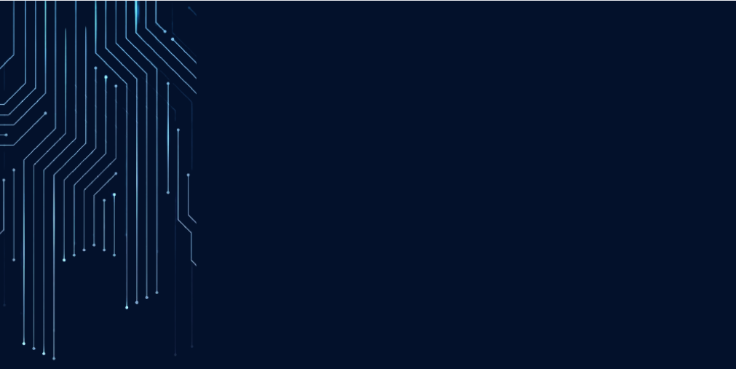

Integriy Check
~ The backend creates a SHA-256 hash of the file to ensure it hasn’t been tampered with.
~Blockchain Recording (Ethereum Smart Contract)
~The file’s IPFS hash and metadata are stored on the blockchain.
~This guarantees your record to be immutable and verifiable.
~Secure QR Code for Doctors
~A unique QR code is generated for temporary, read-only access.
~Doctors can scan it to view your records securely, without compromising your privacy.

Slide 9

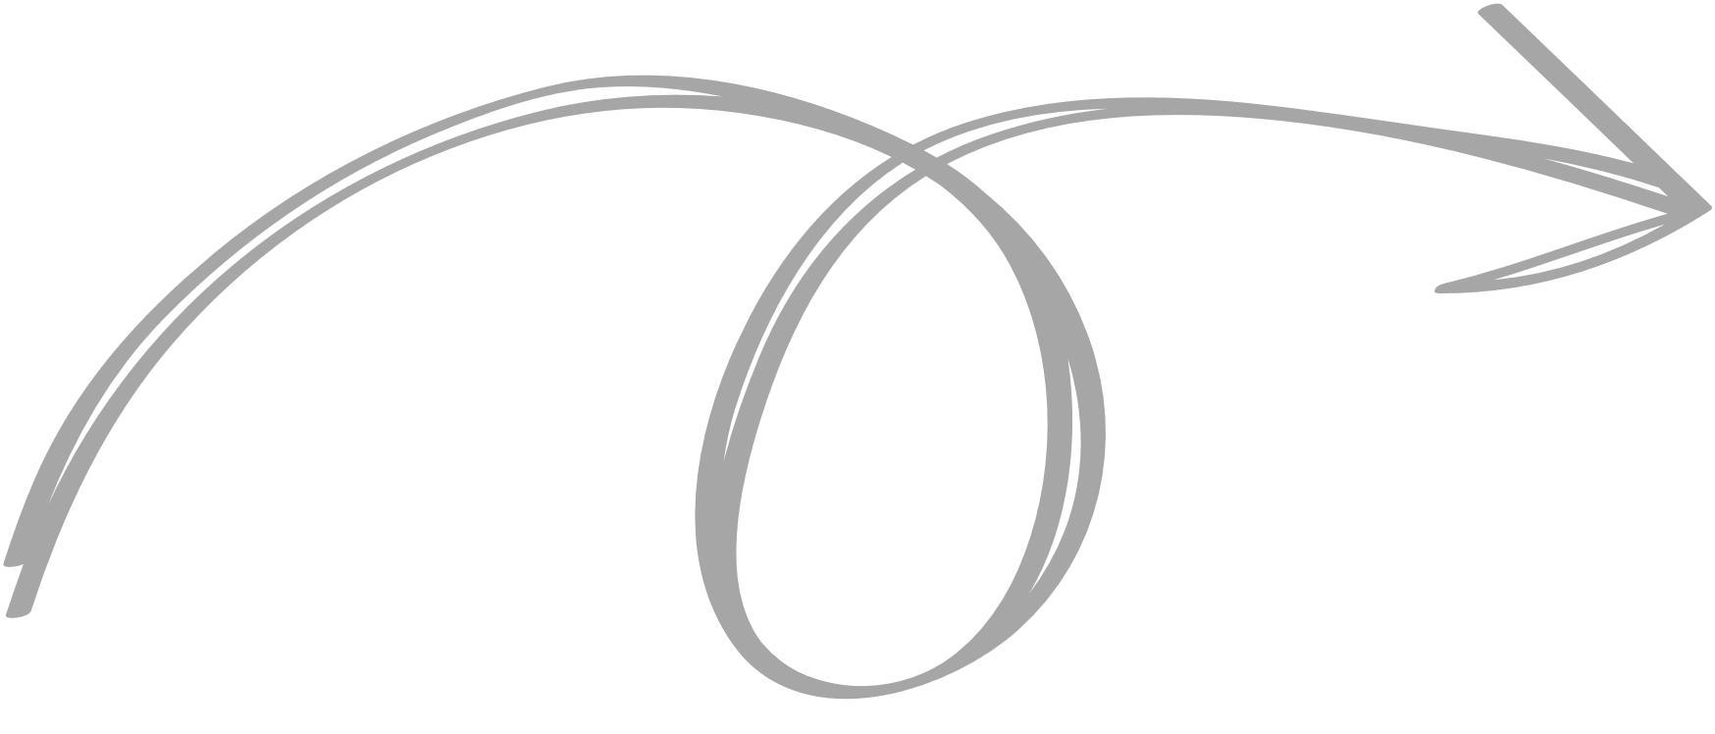
User Roles & Functionalities
>>Our system is built on a clear and simple power dynamic: the patient has total control.
ROLE FUNCTIONALITIES
PATIENT
can login,upload records,view full medical history
and generate secure QR codes to share specific
documents.
DOCTOR
can scan a patient-provided QR code
to get temporary,view only access to specific
records,no login required.

Slide 10
Technology Stack:
MediWallet is built using a modern full-stack approach:
LAYER TECHNOLOGIES
FRONTEND
React.js, HTML5, CSS3, ethers.js
BACKEND
Node.js, Express.js
BLOCKCHAIN
Solidity, Ethereum (Ganache for local dev)
DECENTRALIZED STORAGE
IPFS (InterPlanetary File System)
FILE HASHING
SHA-256
AUTHENTICATION
JSON Web Tokens (JWT)
QR CODES
qrcode.react

Slide 11


SECURITY AND PRIVACY MODEL
>> Security isn’t just a feature—it’s the foundation of MediWallet.
>>Privacy by Design: Your identity and your medical data are kept separate. Files stay off-chain on IPFS, while the blockchain keeps an immutable proof that the file exists.
>>Content-Addressed Storage: Files are referenced by their unique content hash. Any change to a file instantly changes its hash, so tampering is easy to detect.
>>Patient-Controlled Access: The QR code is the key. Only the patient can generate and share it, giving explicit, revocable consent every time.
>>End-to-End Integrity: Every uploaded file gets a hash that’s logged on the blockchain, creating a verifiable audit trail. You can always prove your records are authentic and unaltered.

Slide 12
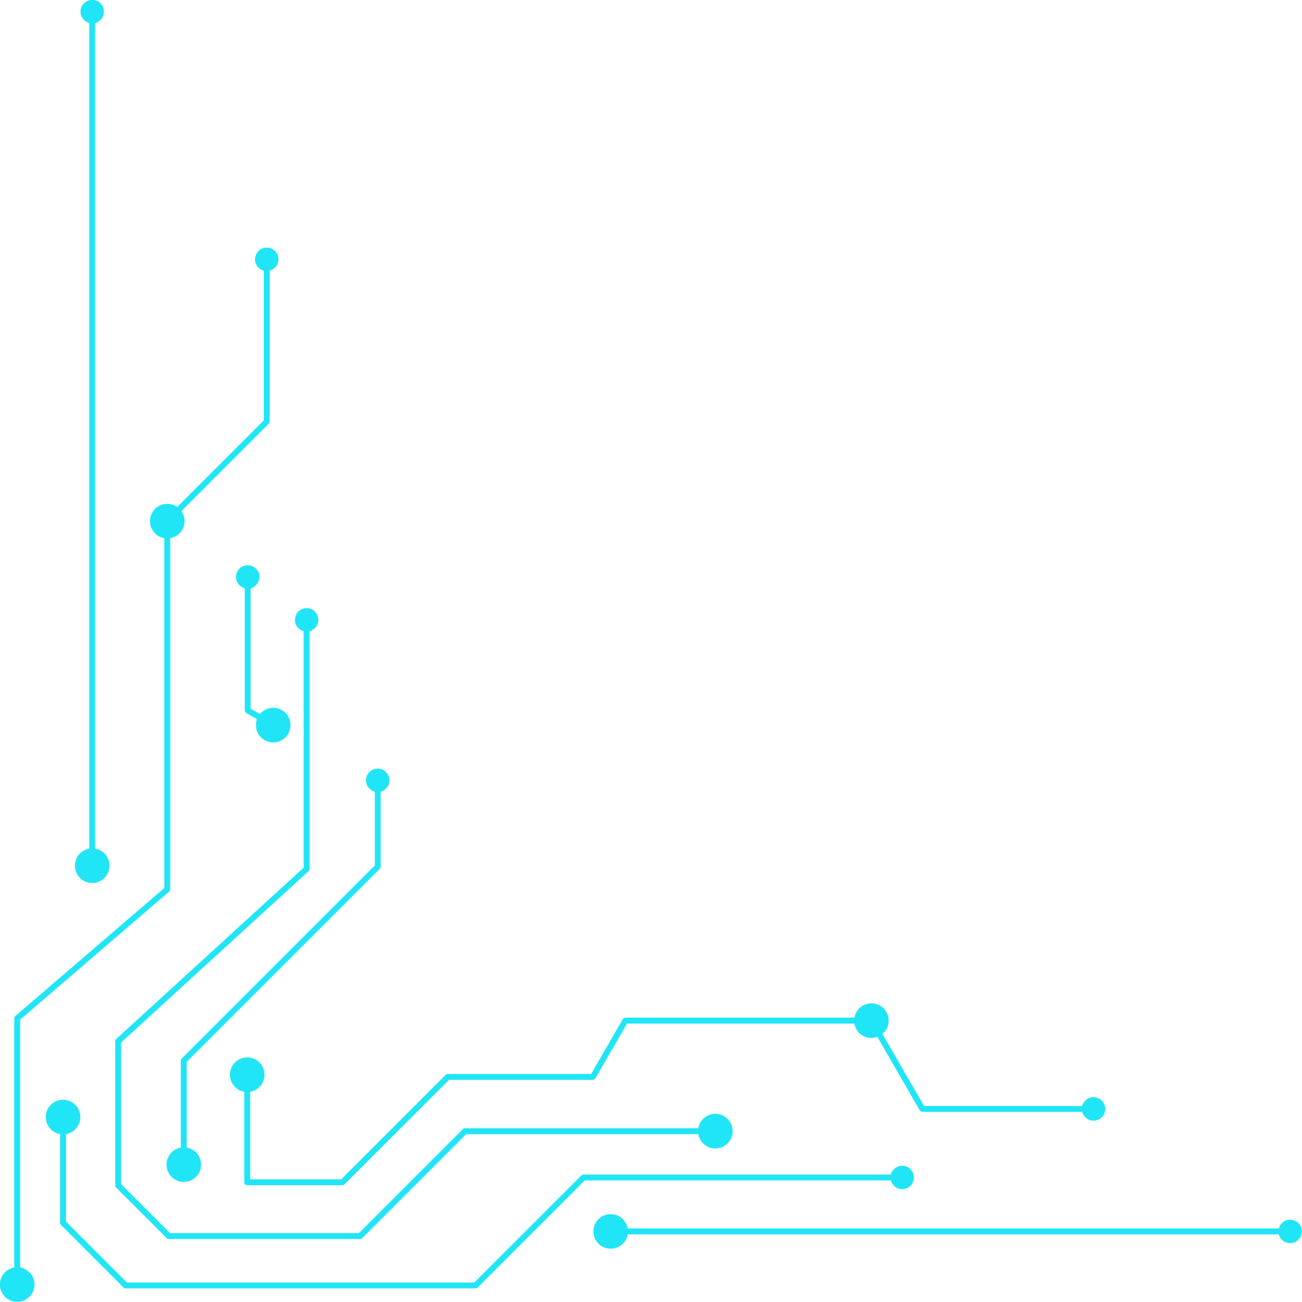
DEMO FLOW:
~Let’s walk through the “Golden Path” of MediWallet:
~Login & Upload: The patient logs in and uploads a new PDF lab report.
~Decentralize & Verify: The file is stored on IPFS, and its unique hash and timestamp are recorded on the blockchain.
~Generate & Share: The patient clicks “Share,” generating a unique QR code.
~Scan & View: A doctor scans the QR code using their device.
~Secure Access: The doctor gets instant, read-only access to the report. The patient shares the record while keeping full control—no downloads, no edits.

Slide 13

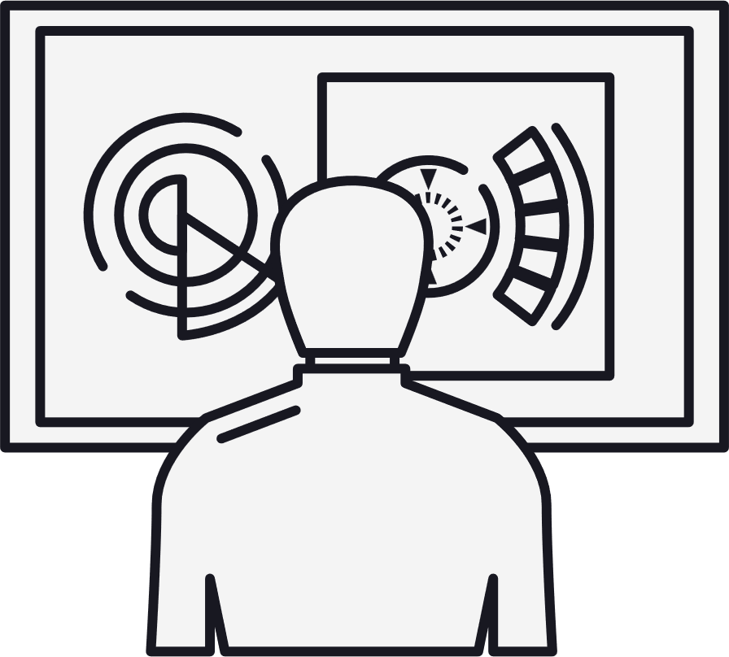
FUTURE SCOPE:
>>MediWallet is just getting started—our platform is built to grow.
>>Mainnet & Layer-2 Integration: Move from Ethereum Testnet to a real network and Layer-2 solutions like Polygon or Arbitrum for faster, cheaper transactions.
>>EMR/EHR Integration: Build APIs so hospitals can securely send records to a patient’s VeriVault with permission.
>>Insurance & Pharmacy Access: Let users safely share diagnoses or prescriptions with insurers and pharmacies.
>>AI Health Insights: Add AI features that summarize lab reports in simple, easy-to-understand language for patients.
>>Emergency Access Protocol: Create a “break-glass” option for patients to give emergency access to a trusted contact in critical situations.

Slide 14
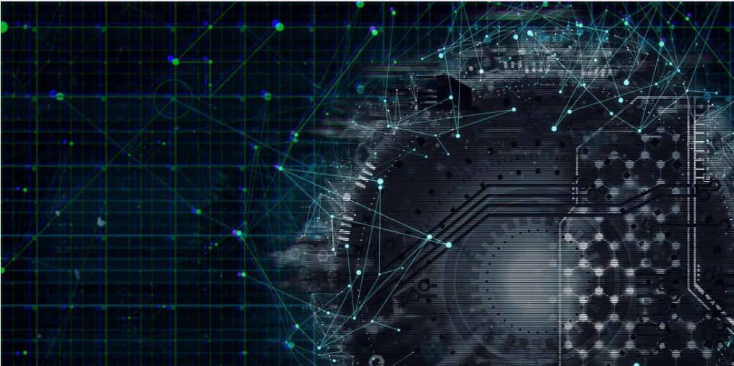
THANK YOU
~ Team MediWallet

